Slide 1
User Documentation and Online Help
(Shneiderman and Plaisant, Ch. 12)

Slide 2
Introduction
User Manuals, Online Help, and Tutorials
Why ???
“In learning about computer systems many people experience anxiety, frustration, and disappointment.”
  Shneiderman
Even though increasing attention is being paid to improving interface design, complex systems can still benefit both paper and online help
  According to Shneiderman
We’ll take a really quick look at some issues …
Forms of paper user manuals – each has its utility (usefulness):
  Install manual
  Brief getting-started notes
  Introductory tutorial
  Thorough tutorial
  Detailed reference manual
  Quick reference card
  Conversation manual

Slide 3
Introduction
User Manuals, Online Help, and Tutorials
Forms of online materials:
  Online manual
  Online help
  Context-sensitive help
  Online tutorial
  Animated demonstration
  Guides
  FAQs
  Online communities, newsgroups, listservers, e-mail, chat, and instant messaging
Again, both paper and online useful
  Consider use of documentation and the user’s goal:
User’s Goal: | Paper: | Online:
I want to buy it | Sales brochure, fact sheet | Animated demonstration
I want to learn it | Tutorial | Manual, tutorial, guide, animated demonstration
I want to use it | User manual | Manual, help, context-sensitive help
I want to solve a problem | FAQ | Help, FAQ, online community

Slide 4
Paper versus Online Manuals
Reasons to have online manuals:
  Physical advantages: need not allocate physical workspace
  Navigation features: rapid information search, searching, linking to external materials
  Interactive services: bookmark, tagging, graphics, sound, color, animations, etc.
  Economic advantages: cheaper to duplicate and distribute than paper documentation
But, advantages can be compromised by potentially negative side effects
  Displays may not be as readable as paper manuals
  Each display may contain substantially less information than a sheet of paper
    Screen display, in general, has advantages and disadvantages
  User interface of online help systems may be novel and confusing to novices
    Possibly, yet another interface …
  Extra mental effort required for navigating through many screens may interfere with concentration and learning, and annotation can be difficult
  Splitting display between work and help or tutorial windows reduces the space for work displays
  Small devices such as cell phones do not have enough display space to provide online help

Slide 5
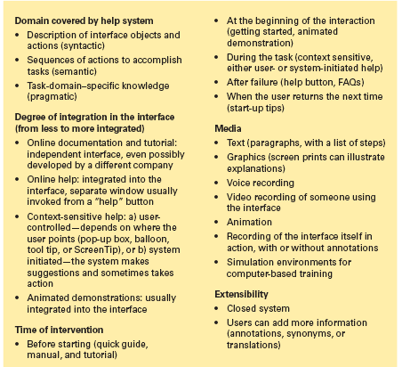
Taxonomy: Diverse ways of providing guidance to users online user documentation, online help, and tutorials
Taxonomy:
  How to divide up the elements of documentation, online help, tutorials
  Domain covered by help system
  Degree of integration in the interface
  Time of “intervention”
  Media
  Extensibility

Slide 6
Reading from Paper vs. Displays
Empirically,15% to 30% slower task times for comprehension or proofreading of text on computer displays, compared to on paper
  Cf. supplementary reading for details, Noyce and Garland, 2008
“Technology” of reading from paper evolved over hundreds of years
E.g., fonts
  Serif fonts evolved for paper readability – and works great
  San serif fonts are appropriate for today’s electronic displays
    Below are same font size, ppt 16 and 12, but serif and sans serif:
  Now is the time for all good men to come to the aid …
  Now is the time for all good men to come to the aid …
  Now is the time for all good men to come to the aid …
  Now is the time for all good men to come to the aid …

Slide 7
Reading from Paper vs. Displays
Potential Disadvantages in Reading from Displays – 1/2
Poor fonts, especially on low resolution displays
  Resolution
Low contrast between characters and the background
  Recall, color contrast
Fuzzy (blurred) character boundaries
  If too close
Emitted light (displays) more difficult to read by than reflected light (paper )
Glare may be greater on displays
Screen flicker can be a problem
  E.g., rarely, but in florescent light
Curved display surface of some screens may be problem

Slide 8
Reading from Paper vs. Displays
Potential Disadvantages in Reading from Displays – 2/2
Small displays require more frequent “page turning “
Reading distance can be greater than for paper
Displays are fixed in place
Display placement may be too high for comfortable reading
Layout and formatting problems
Reduced hand and body motions with fixed- position as compared to paper displays may be more fatiguing
Rigid posture for displays may also be fatiguing
Unfamiliarity of displays and anxiety of navigating the text can increase stress
  From interface

Slide 9
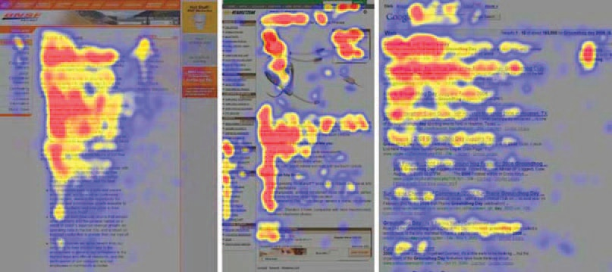
Reading from Paper vs. Displays
As seen, often used in reading studies
The heatmaps from the eyetracking study. Red indicates the area where the user
looked most, yellow indicates fewer views, and blue indicates the fewest views.
Gray is used for areas that were not viewed. The image on the left is from an article
in the “About us” section of a corporate web site, the center image is a product
page on an e-commerce web site, and the image on the right is from a search
engine results page (Jakob Nielson).

Slide 10
Contd…
Gaining a better understanding of users reading patterns in online environment is important.
Study using eye tracking and displaying where and how users viewed a web page clearly shows an F-shaped pattern.
This indicates that users do not read online text word by word.
The beginning paragraphs should contain the most important information; after reading them users tend to scan down the left side of the page, so the words they see there should also carry the important information content (Nielsen, 2006).

Slide 11
Shaping the Content of Manuals
Traditionally, training and reference material were paper manuals “often written by junior member of development team” (Shneiderman)
  Often poorly written
  Not suited to the background of the users
  Delayed or incomplete
  Not tested adequately
The benefits of well-designed manuals include shorter learning times, better user performance, increased user satisfaction, and few calls for support
The “active user paradox”:
  Users’ eagerness to conduct meaningful activities often stops them from spending time “just” learning, and therefore their skills remain mediocre (average)
  Applicable to all task in fact …

Slide 12
Shaping the Content of Manuals
Minimal manuals encourage active involvement with hands-on experiences
Carroll's guided exploration:
  choose an action-oriented approach
  anchor the tool in the task domain
  support error recognition and recovery
  support reading to do, study, and locate
Show numerous well-chosen screen prints that demonstrate typical uses (predictive model)
Components of well designed manuals:
  Table of contents and index required
  Glossaries for clarifying technical terms
  Appendices for error messages

Slide 13
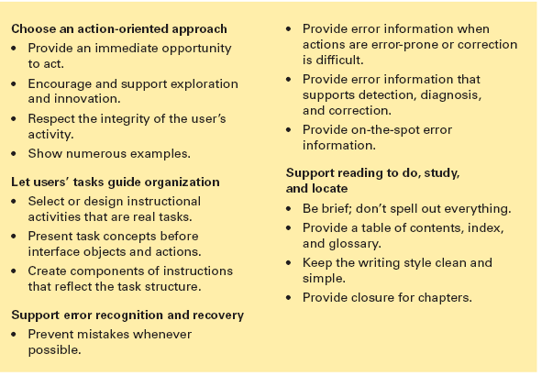
User manual guidelines based on practice and empirical studies (Carroll et al.)

Slide 14
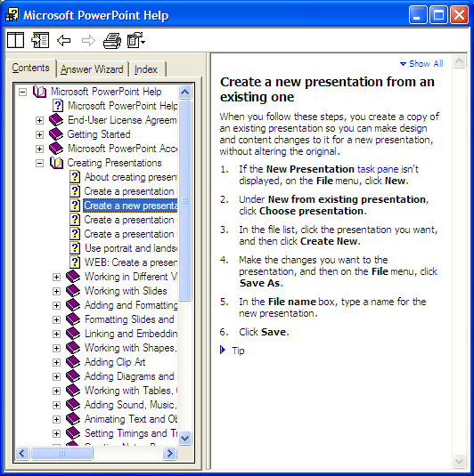
Example – Electronic Analog to Paper
Powerpoint – Automated table of contents analog to paper manual

Slide 15
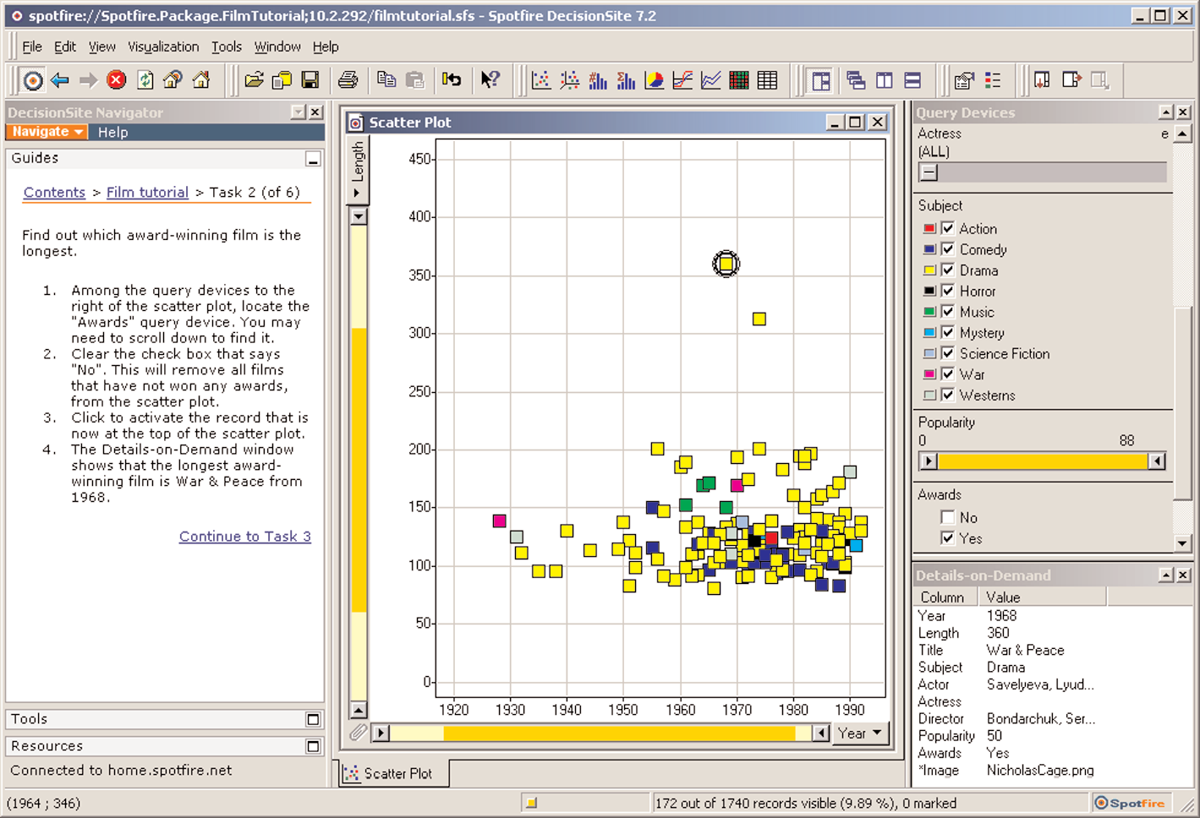
Example: Online Tutorial
Spotfire – Guiding users while they learn the system

Slide 16
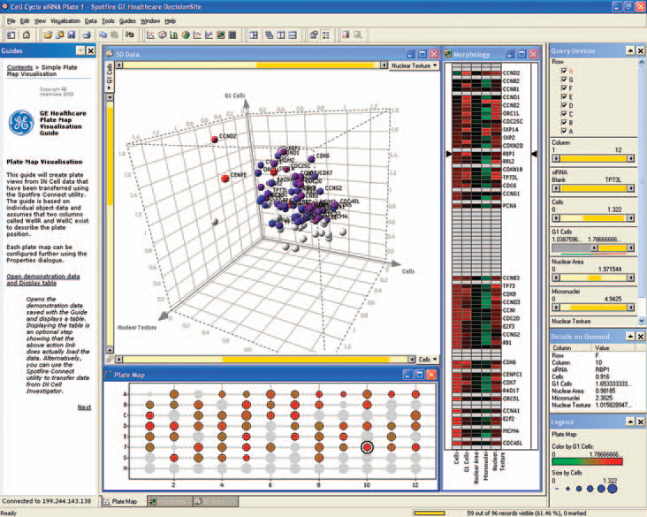
The discovery tool Spotfire™ provides examples that guide users while they learn to use the interface

Slide 17
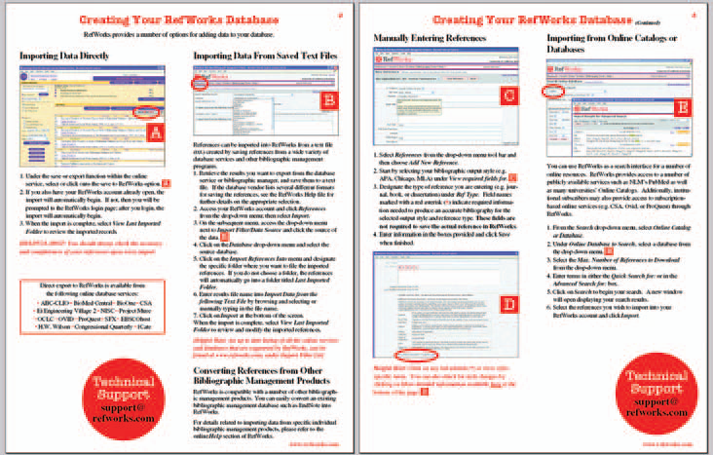
How highlighting, fonts etc. helps user
Two pages from the Quick Start guide from RefWorks.com, an online research
management, writing, and collaboration tool. Different-sized fonts and different
colors are used to help the user scan the material, and large letters (A, B, C, etc.) are
used to guide the user through the material. Helpful hints are also indicated
(http://www.refworks.com).

Slide 18
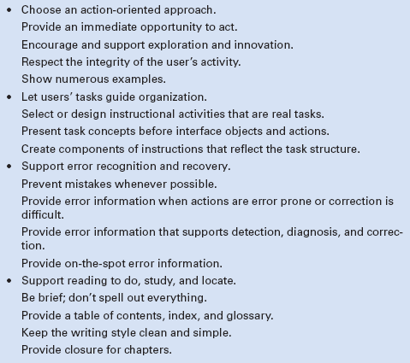
Guidelines for User Manuals
From Shneiderman:
  Cf. Carroll

Slide 19
(Basic) Organization and Writing Style
(see Shneiderman for details)
Assuming that the author has acquired the technical content, the primary job in creating documentation is to understand the readers and the tasks that they must perform.
  Precise statement of educational objectives
  Present concepts in a logical sequence with increasing order of difficulty
  Ensure that each concept is used in subsequent sections
  Avoid forward references
  Construct sections with approximately equal amounts of new material
  Need sufficient examples and complete sample sessions
  Choice of words and phrases important
  Style guides for organizations attempt to ensure consistency and high quality
  Writing style should match users' reading ability

Slide 20
Online Help
Kearsley's guidelines for online help systems:
  Make system easy to access and easy to return from
  Make help as specific as possible
  Collect data to determine what help is needed
  Give users as much control as possible over the help system
  Make help messages accurate and complete
  Do not use help to compensate for poor interface design

Slide 21
Online Manuals, 1
Reproduction of printed manuals online:
  paper page layouts may not convert well
  dealing with figures problematic
  attractive if users have large enough display (full page)
  close match between printed and online versions useful
Enhanced by special online features:
  string search
  multiple indices
  multiple tables of contents
  tables of figures
  electronic bookmarks
  electronic annotations (a note added to a text, book, drawing, etc., as a comment or explanation)
  hypertext traversal
  automatic history keeping

Slide 22
Online Manuals, 2
Most effective if manuals redesigned to fit electronic medium to take advantage of:
  multiple windows
  text highlighting
  color
  sound
  animation
  string search with relevance feedback
Properly designed table of contents that can remain visible to side of text page vital
Novices need tutorials
Intermittent knowledgeable users can handle concise descriptions of interface syntax and semantics
Keyword lists improved by clustering into meaningful categories

Slide 23
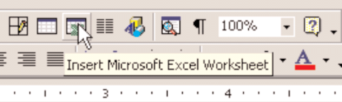
Online Help
(from Shneiderman)
Online Help
  Traditionally, little information about how to assemble actions to perform tasks
  Probably most effective for intermittent knowledgeable users
  Less useful for novices, who have more need for tutorial training
  Users expect to be able to search the full text of online documents
  Expanding and contracting table of contents can be combined with search
  The online help and support center for Microsoft Windows XP contains articles/topics and search options
  An answer wizard can respond to natural language requests
Context-sensitive help: (monitor the cursor location and provide helpful information about the object under the cursor)
  User-controlled, interactive object help
    Based on the interactive widgets in the interface
    Produce information about object after mouse hover
  Intelligent help (Another approach)
    Users’ interaction history, a model of user population, and a representation of their tasks to make assumptions about what users want
    Development of intelligent help systems face serious usability challenges
    Clippey
  Hybrid approaches
    Initiative is shared between the user and system
    Unobtrusive (attracting attention) advice from system, but requires space

Slide 24
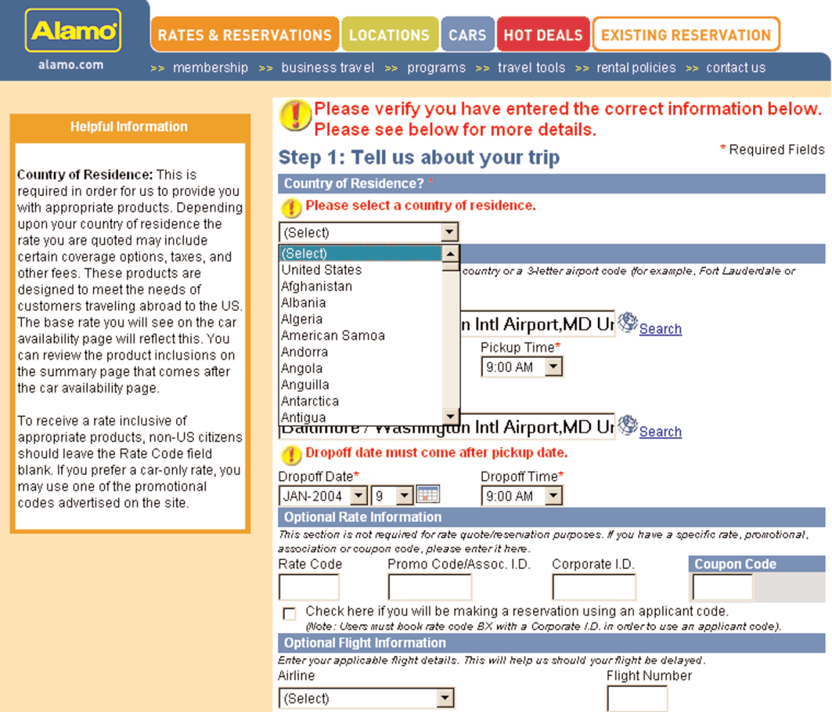
Example
Hints, ongoing direction, etc.
See Fig: 12.8

Slide 25
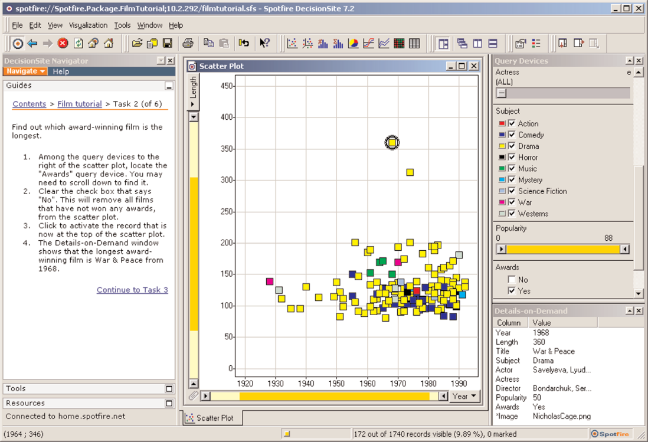
Online Tutorials
Online tutorials
  Does not have to keep shifting attention between screen and manual
  Practices skills to use system
  Can work alone at an individual pace and without the embarrassment of mistakes made in front of others
  Start-up tips
  eg: introductory tutorial for the Adobe Photoshop package

Slide 26
Online Demonstrations and Guides
Demonstration systems
  Distributed on disk, CD-ROM, or over Internet
  Designed to attract potential users
  Typically show off system features using animation, color graphics, sound, etc.
  User-interface requirements are to
    capture and maintain user interest
    convey information
    build positive product image
  Typical controls
    automatic or manual pacing
    length of demonstration (short versus in-depth)
    stop, replay, skip
  A screen capture animation is easy to produce with standard tools such as Camtasia
  Games often have a 30 second demonstration

Slide 27
Online Demonstrations and Guides
Guides
  Audio and video recording of human guides or cartoon figures to lead users through information
  GUIDES 3.0 project
  Audio tours of art galleries
  Audio or video lectures may be played on a computer or a separate system
  Video Professor

Slide 28
Online Communities for User Assistance
Instead of natural – language conversations with computers to get help, interaction with other people online is proving to be effective and popular.
This communal approach may employ e-mail, chat or instant messaging for question asking and responses (Novick et al., 2007).
Questions can be sent to a designated help desk or staff members, or posted on a discussion board. Eg: google groups (see Fig: 12.14).
Help networks using email
  sent to designated help desk or staff person
  sent to general list within organization
  users must publicly expose their lack of knowledge
  risk of getting incorrect advice
Communal approach means low cost for software maintenance
Microsoft and others actively encourages it
Frequently asked questions (FAQ) lists for newcomers

Slide 29
Development Process
.Guidelines:
  Seek professional writers and copywriters
  Prepare user documentation early (before implementation)
  Set up guidelines documents and coordinate and integrate across all involved departments
  Review drafts thoroughly
  Field-test early editions
  Provide a feedback mechanisms for readers
  Revise to reflect changes regularly

Slide 30
Assignment
  Online documentation vs online help vs online tutorial ???

